Slide 1
The Latest in HIV Prevention
Jeannette Southerly, BSN, RN, ACRN

Slide 2
HIV Prevention
Prevention is a critical component of the response
HIV prevention is:
Primary prevention: reduce risk of becoming infected with HIV
Secondary prevention: reduce risk of HIV transmission to others and to keep that person as healthy as possible

Slide 3
5 CDC Prevention Concepts
Education and counseling of people at risk on how to prevent infection and adopt safer sexual behaviors
Identification of the asymptomatic infection and the symptomatic patient who may not seek diagnosis and treatment
Effective diagnosis and treatment of infected persons
Identification, evaluation, treatment and counseling of sex partners of infected persons
Pre-exposure vaccination of those at risk for vaccine-preventable STIs

Slide 4
National HIV/AIDS Strategy (NHAS) (released 7/13/10)
Three major goals
Reduce number of people who become infected w/HIV.
Increase access to care and optimize health outcomes for people living with HIV.
Reduce HIV-related health disparities.
Serves as a roadmap for policymakers, partners in prevention, & the public on steps the US must take to lower HIV incidence, get people living with HIV into care, and reduce HIV-related health disparities.
Notes:
This is not a budget document.

Slide 5
Ending the HIV Epidemic
“In the State of the Union Address on February 4, 2019, President Donald J. Trump announced his Administration’s goal to end the HIV epidemic in the United States within 10 years.”
Goal
75% reduction in new HIV infections in 5 years
At least 90% reduction in 10 years.

Slide 6
Challenges to Prevention
No HIV testing = no impact on HIV prevalence
Behavior change difficult
Stigma may deter a person from seeking HIV info or testing
Because of the role that sex/drugs play in HIV, many sensitivities in addressing HIV prevention
Gender/cultural factors, poverty
The need for us to be more efficient and aggressive regarding HIV prevention

Slide 7
HIV Prevention / Health Promotion
Consists of the following topics:
Prevent transmission
Promote healthy lifestyles
Promote sexual health
Treat drug abuse
Sexual & drug use risk reduction
Ensuring health care access

Slide 8
Prevention: provider based
Prevention also includes:
Incorporate risk assessment/sexual history
Encourage HIV/STI testing
Identify/treat STIs
Offer interventions for behavior change
Encourage testing/counseling for at-risk partners
Communicate prevention messages

Slide 9
Partner Notification Partner Counseling and Referral Services (PCRS)
Practice of identifying and contacting sexual partners of infected individuals to inform them of:
their risks of exposure
refer them for testing and treatment when appropriate
often provide education to help prevent further exposure and transmission.
“1865, Quebec, Canada An act allowed for judge-ordered identification, examination, and treatment of sexual partners of infected military personnel— with or without consent.”
Method used in the 1940s to curb the spread of syphilis

Slide 10
Notification of Partners
Provider referral: your healthcare provider notifies your partner(s) for you.
Self-referral: you notify your partner(s) yourself.
Contract referral: you make a “contract” to notify your partner(s) by a particular date. If, by the contract date, your partners have not come in for counseling and testing, the health department will contact them.
Dual referral: you and the health department will notify your partner(s) together.

Slide 11
Biomedical Methods to Prevent HIV Transmission

Slide 12
Vaccine
Five times an HIV vaccine has reached clinical trials in humans.
Three of these approaches have been abandoned because they weren’t successful (researchers shoot for at least 50% efficacy for a vaccine to cont.)
One ongoing clinical trial is in Thailand which began November 2016.
One study, called APPROACH, uses a new kind of vaccine that targets several strains of HIV simultaneously, and appears to not cause any lasting side effects in people who receive it.
Anthony Fauci, MD cautions these results are still preliminary, and further testing in people is needed before any kind of vaccine can be brought to market.
An HIV vaccine is a more realistic prospect today than a decade ago and an optimistic forecast of HIV vaccine availability is that one might be available by 2030.*

Slide 13
Broadly Neutralizing Antibodies (bna)
Recognize many different strains of HIV
Target regions of HIV that do not mutate and vary little between viral subtypes
Less than 20% of people living with HIV make these antibodies
Can be isolated and reproduced in the lab
Infusions of bna are being tested as an HIV prevention method in a clinical trial, AMP. (report results will be in 2020)
Several other studies are testing different combinations

Slide 14
Topical Microbicides
Potentially offer protection when applied:
Mucosally
Vaginally
Rectally
Current and ongoing clinical trials for safety and efficacy

Slide 15
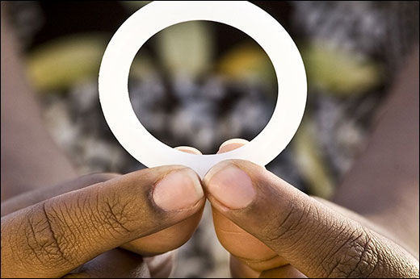
Vaginal Ring for HIV Prevention
In an open-label study of women in southern and eastern Africa, a vaginal ring inserted once a month and slowly releases an antiviral drug was estimated to reduce the risk of HIV by 39% according to statistical modeling.
The study found participants appeared to use the ring more in the open-label study than in a previous clinical trial
Presented at the 10th IAS Conference on HIV Science (IAS 2019) in Mexico City.

Slide 16
Male Circumcision and HIV Prevention
The inner foreskin contains cells that HIV targets to enter the body.
Small tears or genital ulcers on the foreskin can increase HIV risk.
Circumcision only protects men from acquiring HIV, reducing their risk by 60%. (fewer positive men could mean fewer positive women)
It does not reduce risk of sexual transmission of HIV onwards to a female or male partner.

Slide 17
Treatment as Prevention (TasP)
Using ARVs to decrease risk of transmission.
ARVs reduces HIV viral load in blood, semen, vaginal fluid and rectal fluid to very low levels ('undetectable')
In 2011, a landmark study, HPTN 052, showed early initiation of ARVs (people with CD4 count 350 t0 550) reduced HIV transmission to an HIV negative partner by 96%.
Number of follow-up studies have reported significant reductions in transmission & numbers of new infections averted
This has led to the idea TasP could be utilized as part of a 'test and treat' strategy by increasing testing and treatment coverage as well as decreasing community viral load.

Slide 18
U = U
“U=U” is a simple but hugely important campaign based on a solid foundation of scientific evidence.
It has already been successful in influencing public opinion, causing more people with HIV (and their friends and families) to comprehend that they can live long, healthy lives, have children, and never have to worry about passing on their infection to others."

Slide 19
U = U
A person living with HIV is considered to have an ‘undetectable’ viral load when ARV treatment has brought the level of virus in their body to such low levels that blood tests cannot detect it.
There is no risk of passing on HIV if your doctor has confirmed that you are undetectable (or virally suppressed), you continue taking your treatment and attend regular viral load monitoring appointments.
Being undetectable isn’t a constant state and if you stop taking your medication then your viral load will go back up again.

Slide 20
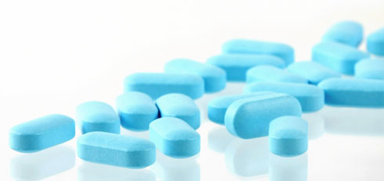
What is PrEP?
Pre-exposure prophylaxis Use of anti-HIV medications before an exposure, to reduce the risk of becoming infected
Tenofovir is the most studied agent for PrEP
Properties allow once-daily dosing
No major drug-drug interactions
Safe and well tolerated

Slide 21
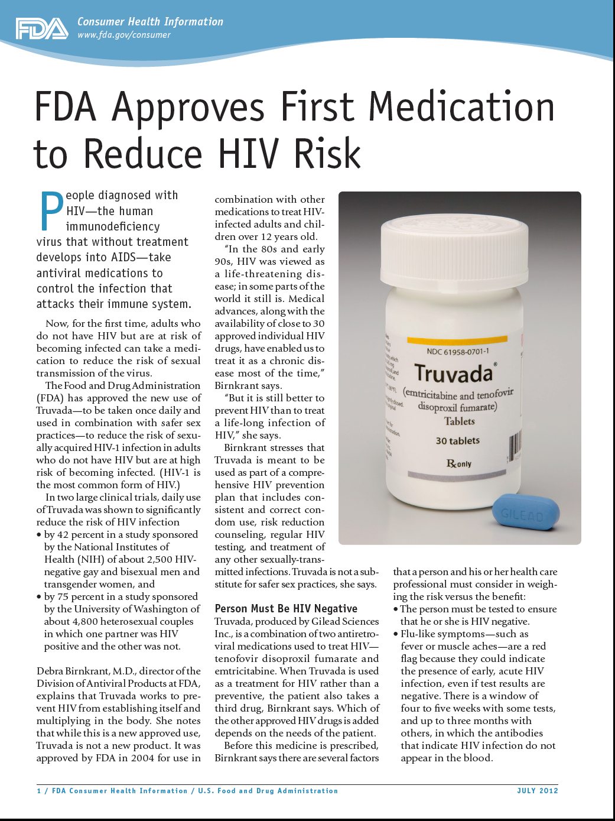
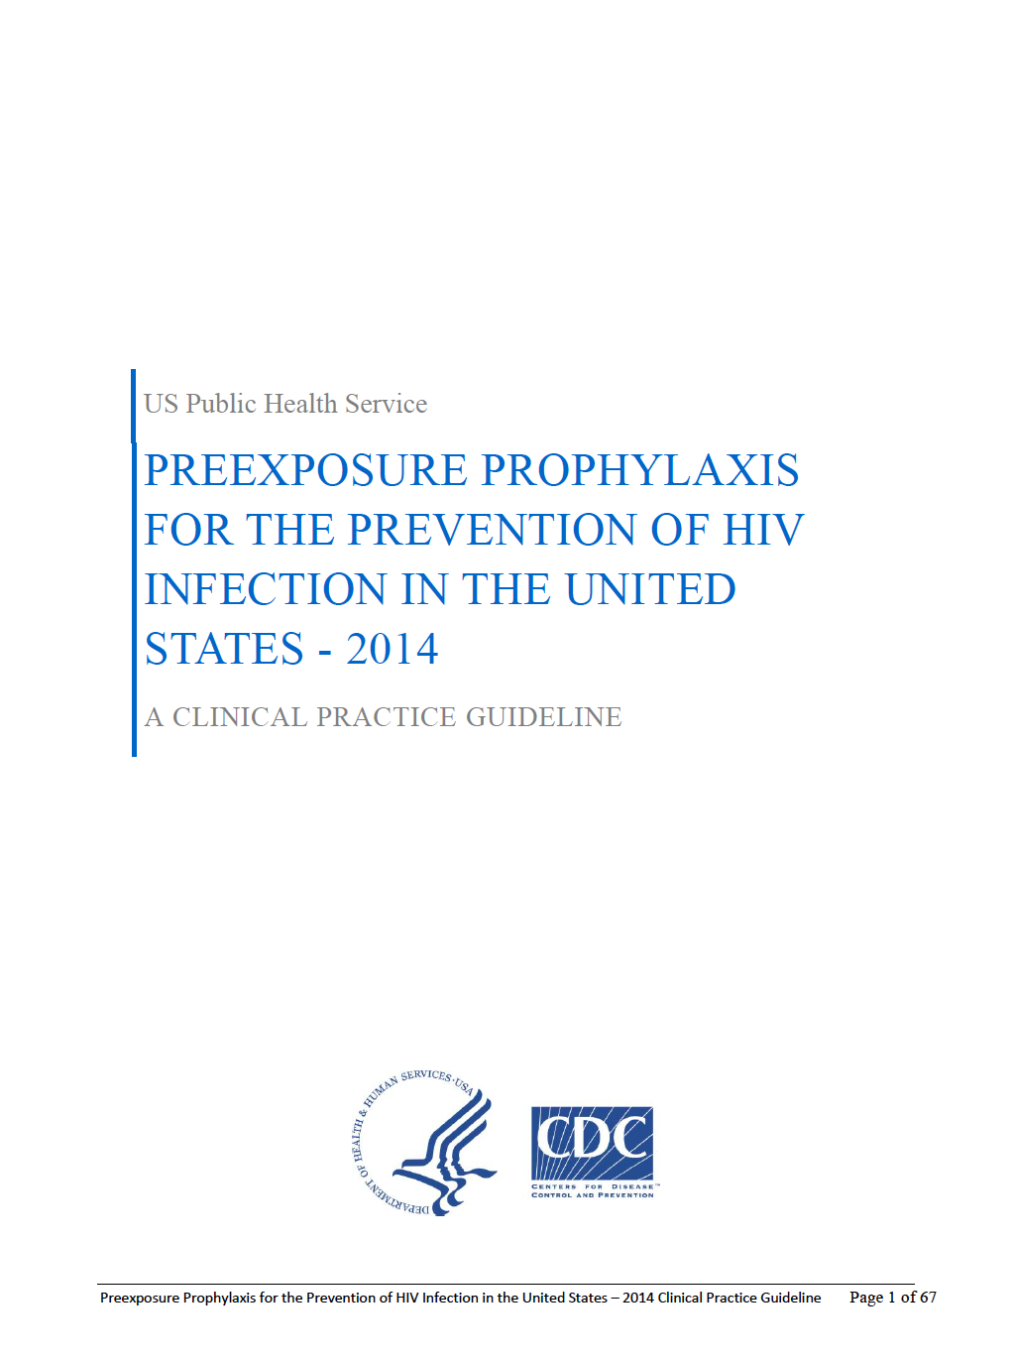
Moving PrEP into practice
July 2012

Slide 22
Adherence is key to PrEP’s efficacy
Protective efficacy (%)
All participants
High adherers
44
62-73
92
~95
44
62-73
Grant RM, et al. NEJM. Dec 2010;363(27):2587-99
Baeten JM, et al. NEJM. Aug 2012;367(5):399-410

Slide 23
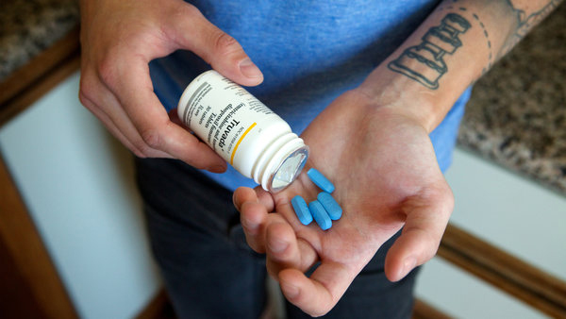
Adherence makes all the difference

Slide 24
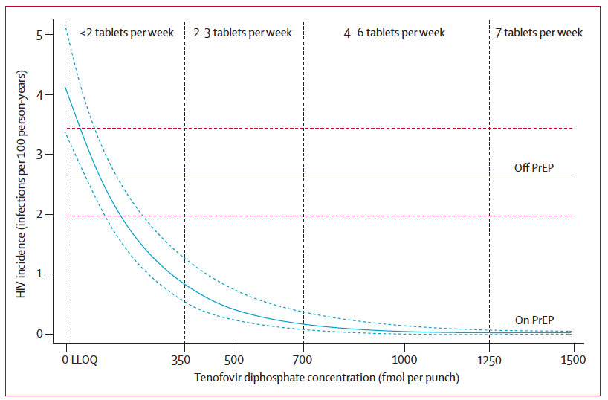
iPrEx OLE confirmed prior estimates
90%
protection
100%
protection
Grant RM, et al. Lancet Inf Dis. Sep 2014;14(9):820-9

Slide 25
Time to optimal protection varies…
Days to Maximum Intracellular Concentration of Tenofovir Diphosphate (TFV-DP)
Something to tell patients:
For receptive anal sex 14 days
For receptive vaginal sex 30 days
For insertive sex or PWID 30 days
Consecutive Days of Oral Dosing
US Public Health Service. PrEP Guideline – 2014.

Slide 26
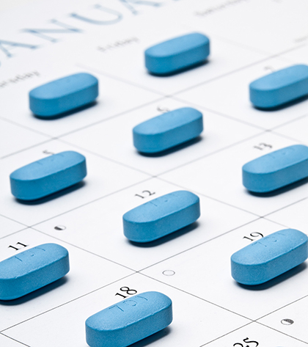
Key points
Daily dosing affords greatest protection
Occasional missed dose probably OK
(less OK for women…)
Nonadherence creates opportunities for infection

Slide 27
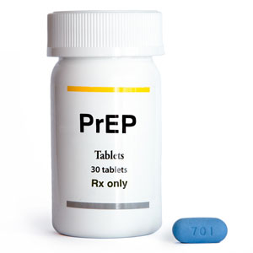
What are the side effects of PrEP?
“Startup syndrome”
Flatulence (3-4%)*
Nausea (8-20%)*
Mild headache (6-22%)*
Symptoms resolve within first 30d, for most
May have some issues with renal function and some bone density loss
* post-marketing reported frequencies (Lexi-Comp)
US Public Health Service. PrEP Guideline – 2014.

Slide 28
Who should get PrEP?
HIV uninfected, plus:
Any HIV+ partner(s)
Condomless sex in past 6m
Any STI in past 6m
High number of sex partners
In high-prevalence area or sexual network
Commercial sex work
Shared injection equipment
Recent drug treatment & current relapse

Slide 29
Paying for PrEP
Out-of-pocket = around $1700/mo.
Insurance covers (even Medicaid) ± pre-auths
Access programs and co-pay assistance
Free from manufacturer if:
no source for insurance or Rx coverage
income <500% FPL (single $58,000 / year)
http://fairpricingcoalition.org/medication-assistance-program-and-co-pay-programs-for-prep/
Schackman BR, et al. Curr Opin HIV/AIDS. 2012;7:587
Juusola JL, et al. Ann Intern Med. 2012;156:541
Gomez GB, et al. PLoS Med. 2013;10(3):e1001401

Slide 30
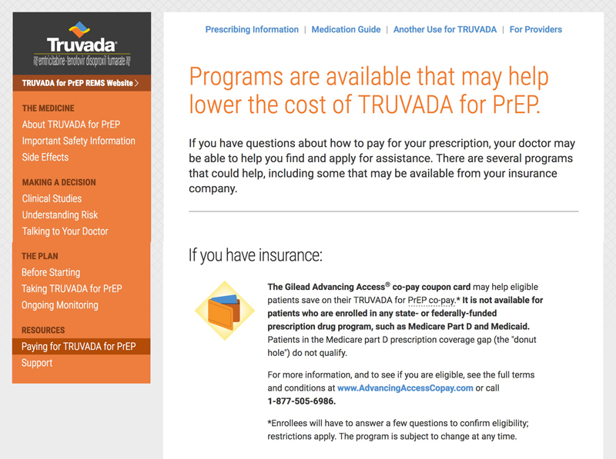
Dedicated assistance program for PrEP
http://start.truvada.com

Slide 31
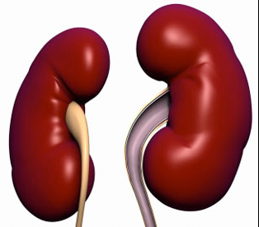
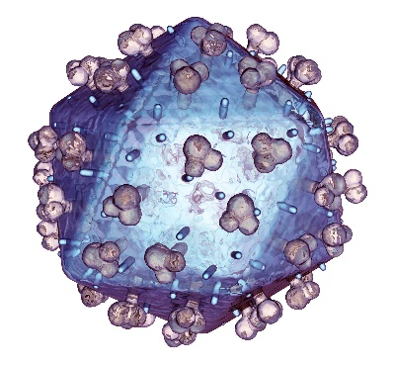
Step 1: Determine clinical eligibility
within 30 days
within 30 days
within 7 days
Viral hepatitis
HBsAg
HBsAb
HCV Ab
Caution if active HBV
Renal function
Creatinine
eCrCl
eCrCl must be ≥ 60 mL/min
PICK ONE
HIV status
Ag/Ab
Rapid (blood)
ELISA / EIA
Must be HIV(–)
→ Maybe RNA, too?
Lab-based (over rapid)
US Public Health Service. PrEP Guideline – 2014.

Slide 32
Step 1: Determine clinical eligibility
Screen for symptoms of acute HIV
Must be free of these, within prior 4 weeks:
Fever (75%)
Fatigue (68%)
Skin Rash (48%)
Pharyngitis (40%)
Cervical adenopathy (39%)
Suspect acute HIV? Send HIV RNA (viral load)
US Public Health Service. PrEP Guideline – 2014.

Slide 33
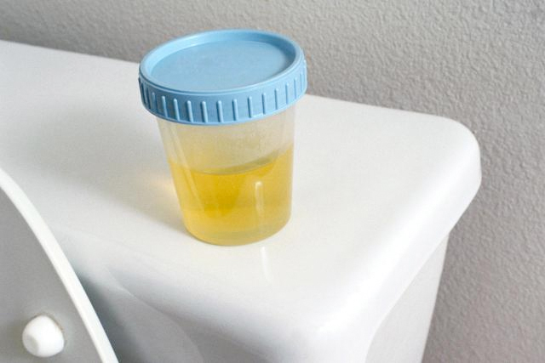
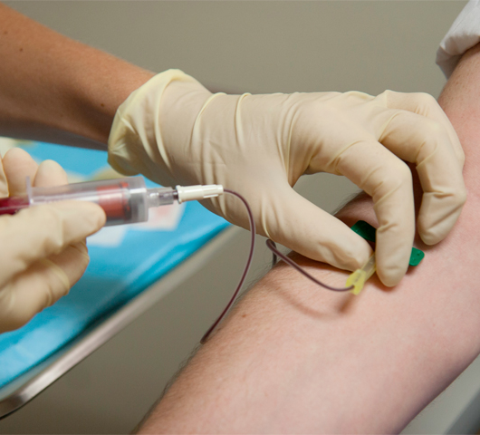
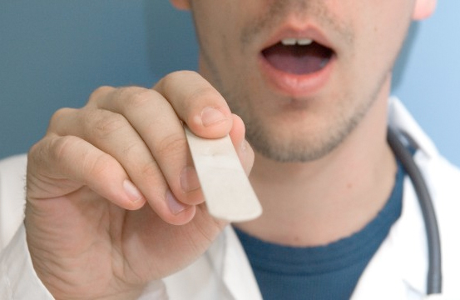
Step 2: Screen for STIs
If not already done in prior 3-6 months:
RPR for syphilis
Gonorrhea and chlamydia
Nucleic Acid Amplicfication testing preferred
Extragenital sites too!

Slide 34
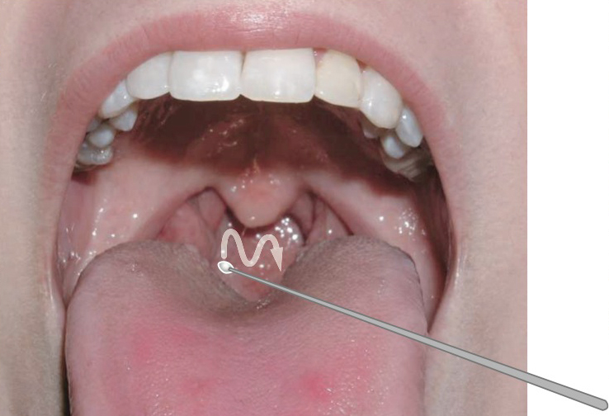
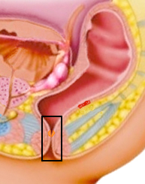
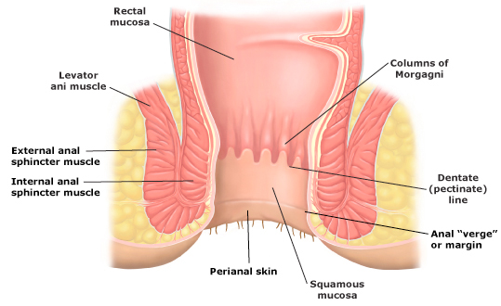
Step 2: Screen for STIs

Slide 35
Step 3: Counsel the patient
Adherence strategies
Pair pill-taking with daily task (even weekends!)
Plugging cell phone in before bedtime
Set an alarm (clock, watch or phone)
Use a pill box
Keep a dose on/near you
US Public Health Service. PrEP Guideline – 2014.

Slide 36
Step 4: Prescribe & follow-up
First Rx: Thirty days, NO refills
Return to clinic in 30 days
Adherence?
Side effects?
Behavior changes?
2nd Rx: Thirty days, 2 refills

Slide 37
Step 5: Maintenance & reassessment
At least every 3 months
Assess adherence, side effects, behaviors
Repeat HIV testing
Prescription renewal
At least every 6 months
Check creatinine and eCrCl
Screen for STIs, if not already done
Determine need – “seasons of risk”

Slide 38
Can HIV break through PrEP?
Patient
On PrEP for 24 months
Likely fully adherent
(based on Dried Blood Spots’ drug levels and Rx refill data)
Knox DC, et al. CROI 2016. Abstract 169aLB
https://www.poz.com/article/meet-man-got-hiv-daily-prep

Slide 39
Can HIV break through PrEP?
Patient
Meets partner on barebacking website
Tried following up afterward, but partner became unreachable
“Negative”
Knox DC, et al. CROI 2016. Abstract 169aLB
https://www.poz.com/article/meet-man-got-hiv-daily-prep

Slide 40
Can HIV break through PrEP?
Patient
p24 antigen positive on routine quarterly testing
No reported symptoms suggestive of acute HIV infection
Resistance testing
Class | Mutation(s)
NRTI | M41L, D67G, 69ins, K70R, M184V, T215E
NNRTI | Y181C
InSTI | H51Y, E92Q
Knox DC, et al. CROI 2016. Abstract 169aLB
https://www.poz.com/article/meet-man-got-hiv-daily-prep

Slide 41
Can HIV break through PrEP?
Patient
p24 antigen positive on routine quarterly testing
No reported symptoms suggestive of acute HIV infection
Donor (inferred)
Acquired (and/or transmitted) resistance
Viremic with resistant HIV (off ARVs or failing)
Resistance testing
Implications
Special, unusual circumstances but could certainly happen again
Any condomless sex poses a risk; lower with PrEP, but never truly zero
Class | Mutation(s)
NRTI | M41L, D67G, 69ins, K70R, M184V, T215E
NNRTI | Y181C
InSTI | H51Y, E92Q
Knox DC, et al. CROI 2016. Abstract 169aLB
https://www.poz.com/article/meet-man-got-hiv-daily-prep

Slide 42
Postexposure Prophylaxis (PEP) Infection Control and Hospital Epidemiology September 2013, vol. 34, no. 9
Updated US Public Health Service Guidelines for the Management of Occupational Exposures to Human Immunodeﬁciency Virus and Recommendations for Postexposure Prophylaxis
David T. Kuhar, MD; David K. Henderson, MD; Kimberly A. Struble, PharmD; Walid Heneine, PhD; Vasavi Thomas, RPh, MPH; Laura W. Cheever, MD, ScM; Ahmed Gomaa, MD, ScD, MSPH; Adelisa L. Panlilio, MD

Slide 43
Average Risk of Transmission After Percutaneous Exposure to Blood
Source Risk (%)
HIV 0.3
Hepatitis C 1.8
Hepatitis B (only if HBeAG) 30.0
(Only confirmed case reported after 1999 was in 2008 in a lab tech who sustained a needle stick while working with live HIV culture) http://www.medscape.com/viewarticle/837919
Notes:
the e-antigen is found in the blood only when there are viruses also present

Slide 44
Who should use N-PEP? Other Exposures
In 2005, CDC concluded N-PEP should be available after HIV exposures that are not work-related.
During unsafe sexual activity (condom breaking during sex), or if they share needles for IDU.
Infants exposed to breast milk from infected woman.
Guidelines were updated in April 2016.
Study of N-PEP in 400 cases of possible sexual exposure to HIV, not one person became infected with HIV.

Slide 45
PEPline
National Clinicians’ Post-Exposure Prophylaxis Hotline (PEPline)
PEPline clinicians will respond to calls between 9 a.m. and 2 a.m. EST.
For urgent occupational exposure needs, please call during these hours or see the PEPline Guidances for Occupational Exposures.
7 days a week
1-888-HIV-4911
http://www.ucsf.edu/hivcntr/services.html#pepline
a joint program of UCSF/SFGH CPAT / EPI Center supported by HRSA and CDC
Notes:
The University of California at San Francisco has established a national clinicians’ postexposure prophylaxis hotline called PEPline, which provides free consultation for clinicians treating occupational exposures to bloodborne pathogens 24 hours a day, 7 days a week.

Slide 46
Protective Barriers: Safer Sex
Male latex or polyurethane condom
Female polyurethane condom
Dental dams, latex squares
Lubricants

Slide 47
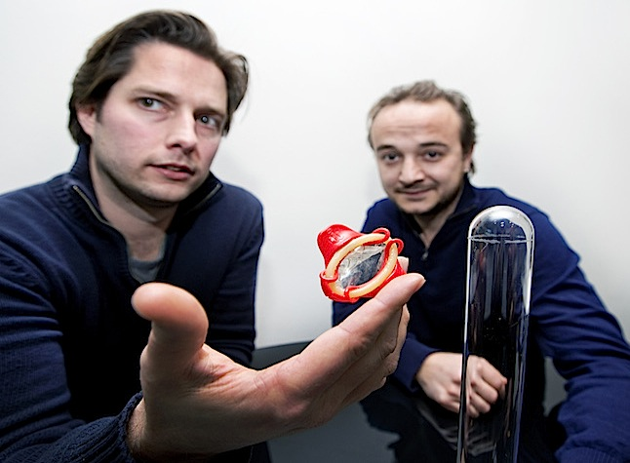
The “Wingman” Condom
“Judged by experts and designers, Wingman condoms was presented the iF Gold Award 2014 award based on the quality of design, degree of innovation, safety, universality and particularly the user-friendliness of the product. The prestigious prize known as the ‘Oscar for product design’ celebrates the 50 best new product designs in the world and has seen previous winners in Nokia, Apple, Porsche and Phillips.”
About the product
Easier: apply with 1 hand in 2 seconds, even in the dark.
Thinner: ultra-thin for a more natural feel, while still being safer.
Safer: no hand-condom contact, air-free tip, the right application every time.
How? Just grab a Wingman by its wings, roll it down until the wings release and... Enjoy!
It is an "almost without" experience!
$12.86 for a pack of 12 on Amazon
http://thepositive.com/winged-man-in-the-bedroom/#sthash.lkeZcIRh.dpuf

Slide 48
Wingman Condom vs Condom Errors
Not squeezing the air from the tip (45%*): Air in tip increases risk of rips and tears. With a Wingman, there’s no need to squeeze air from tip thanks to its air-tight design (air was extracted during assembly). When you unroll a Wingman, you are guaranteed an air-tight fit.
Putting it on inside out and flipping it over to use (11%*): Pre-ejaculate on outside of condom can lead to STIs and unwanted pregnancies. With regular condoms, it’s hard to tell top from bottom. With a Wingman you can see and feel which way is up thanks to W logo on wings. This is the only way it can be applied.
Contact with hands, nails or other sharp objects (5%*): This can damage the condom and lead to breakage. When using a Wingman, you never touch the condom itself.
* Indicates the prevalence of this error (Sanders et al, 2011)

Slide 49
Condom Failure
Late application: Between 17 percent and 51.1 percent.
Early removal: Between 13.6 percent and 44.7 percent.
Unrolling condom before putting it on: 2.1%-25.3% reported completely unrolling a condom before putting it on.
No space at the tip: Between 24.3 percent and 45.7 percent
Failing to remove air: Almost half (48.1 percent) of women and 41.6 percent of men
Inside-out condoms: Between 4 percent and 30.4 percent of people reported rolling on a condom inside out and then flipping it the other way around, potentially exposing their partner to bodily fluids.
Failing to unroll all the way: 11.2 percent of women and 8.8 percent of men had started intercourse before a condom was unrolled all the way.
Exposure to sharp objects: Between 2.1% -11.2% opened condom packets with sharp objects
Not checking for damage: 82.7% of women and 74.5% of men failed to check
No lubrication: Between 16% and 25.8% used condoms without lubrication, increasing the risk of a break.
Wrong lubrication: In about 4.1 percent of sexual events, people used oil-based lubrications with latex
Incorrect withdrawal: Occurring in up to 57% of encounters in one study.
Condom reuse: Between 1.4%-3.3% of study respondents re-used a condom at least twice
Incorrect storage: Between 3.3% and 19.1% stored condoms in conditions outside of recommendations.
Breakage: In various studies, between 0.8% and 40.7% of participants reported a broken condom.
Slippage: Between 13.1 percent and 19.3 percent of participants reported condom slippage.
Leakage: 7.6 percent of men and 12.5 percent of women reporting an experience with a leaky condom.

Slide 50
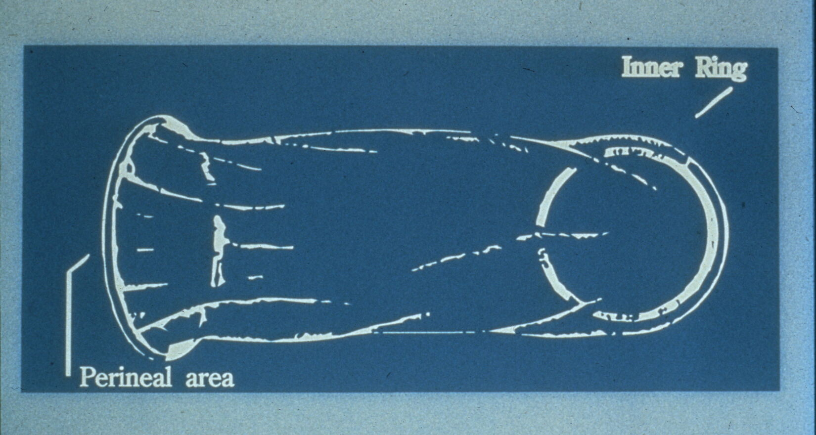
Reality Female Internal Condom FC2 (as of June 2017 need a prescription)
12 pack $28.95/free shipping - fc2.us.com/product/fc2-patient-assistance-program/
If no insurance

Slide 51
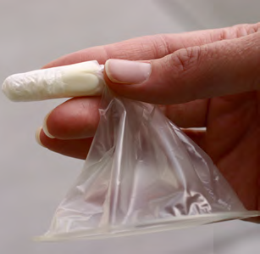
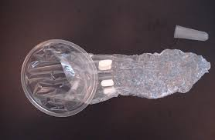
Woman’s Condom by PATH – last phase for FDA approval
Feature | Description
Pouch | 0.03mm polyurethane – loose fit allows good heat transfer offering greater pleasure
Ring | Soft, flexible and keeps condom in place and gently hugs the body. Covers external genitals.
Foam Shapes | 4 small think shapes, cling lightly to vaginal wall, ensuring stability.
Dissolving capsule | Made of polyvinyl alcohol contains the condom pouch and aids insertion.
Lubricant | Unlubricated and supplied with lubricant to be applied at point of use.
Packaging | Aluminum foil laminate to keep the condom fresh.
Post Insertion

Slide 52
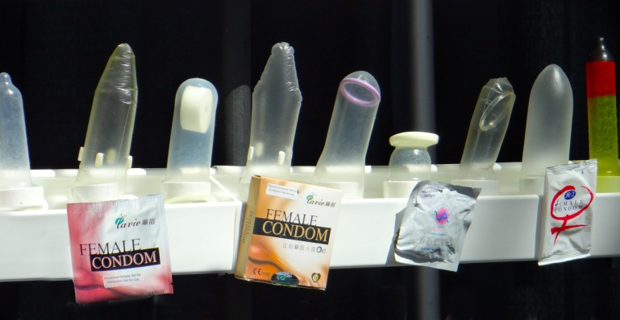
Female Condoms

Slide 54
Lubricants
What do you need to know about Lubes?

Slide 55
Oral Sex and HIV Risk
The risk of HIV transmission through oral sex is much less than anal or vaginal sex – but not zero
Performing oral sex on an HV infected man, with ejaculation, is the riskiest oral sex
Factors that may increase the risk of HIV transmission through oral sex are ulcers, bleeding gums, genital sores and the presence of other STDs.
Centers for Disease Control and Prevention

Slide 56
Oropharyngeal Cancer
Oropharyngeal cancer is rising & according to Dr. Terry Day, director of the Head & Neck Cancer Program at Medical University of SC, its occurring in the young.
CDC states that HPV now causes approximately 63% of oropharyngeal cancers
Estimated 2,370 women and 9,356 men each year
White men the most likely to be diagnosed with HPV positive cancer.
No blood test or Pap test to screen for this cancer

Slide 57
Oropharyngeal Cancer
Study of 88 pts found most common symptoms were a lump in the neck (44%) & chronic sore throat (29%).
HPV-positive pts noticed neck mass, HPV-negative pts sore throat.
Others: pain, difficulty swallowing, and difficulty opening the mouth
Dr. Terry Day, director of the Head and Neck Cancer Program at Medical University of South Carolina, commented clinicians need to inform pts about the possibility of throat cancer when they have a sore throat > 2 weeks, trouble swallowing, or a lump in the neck
Clinicians should refer patients to a specialist for exam and biopsy
Day noted that this type of cancer has a good cure rate even when it has spread to the lymph nodes.

Slide 58
Dental Dams
Trust Dam 5 Pack -- Vanilla
3.5 out of 5 stars 34
$7.25
9 used and new from $6.30
(2 for 1)* Trustex Flavored Oral Sex Latex Dental Dam Condom Sheet - Strawberry
Brand New
$5.93
Buy It Now
Free Shipping
164 sold
3 New & refurbished from $5.10

Slide 59
HIV Risk Reduction
Avoid unprotected sex
Barriers: condoms/dental dams
Limit multiple partners
Get tested
Abstinence
Avoid drug/alcohol use
Don’t share needles for:
Drugs --- what kind?
Tattoos
Body piercing
Use clean needles/works if unable to stop injecting

Slide 60
HIV Risk Reduction
Safer sex recommendations:
Decisions about sexual activity
Do I or don’t I
Decisions about partner selection
Choose someone at low risk??
Decisions about specific sexual practices
Oral vs. vaginal vs. anal

Slide 61
The M word
Masturbation is not emotionally or physically harmful.
In fact, it has a # of physical & mental health benefits:
releases stress and physical tension
orgasms can act as a natural painkiller.
Some women masturbate to relieve menstrual cramps
Research shows orgasms may even prevent endometriosis
One study found that frequent ejaculation may reduce a man's chances of developing prostate cancer
Solo sex is the ultimate form of safer sex — there is no risk of pregnancy or infection.

Slide 62
PREVENTION THROUGH EDUCATION
BEHAVIOR CHANGE
Notes:
HIV is not an easy disease to acquire. Specific targeted prevention efforts should be developed to enhance primary and secondary interventions.

